Slide 1
Data Analytics Internship Task
Demiana Essam

Slide 2
building a machine-learning model to predict the closing price of a given stock based on historical data.

Slide 3
Brief explanation of my approach :
My approach is to first read the data and try to understand it by examining the type of data and drawing some graphs to see whether the relationship between the variables and the target is a direct or inverse relationship or a non-linear relationship. This helps me more in choosing the correct model.
Then I modify and preprocess the data in terms of correcting data types, dealing with missing values, dealing with duplicated data, and dealing with impurities and outliers.
Do some feature engineering like separate the year, month, and day from the date into new columns
Then I examine the spread of the data around its center, normalize the values of the variables, and put them in a standard scaler to facilitate the model’s calculations, because each feature has a different scale from the other.

Slide 4
Brief explanation of my approach :
Then I divide the data into X_train , X_test , Y_train , Y_test and then test more than one model for the regression problem from six models:
LinearRegression
BayesianRidge
DecisionTreeRegresso
RandomForestRegressor
Lasso
Ridge
I choose the best two of them and try to improve them using hyperparameters tuning, and then make the final decision which model I will use.

Slide 5
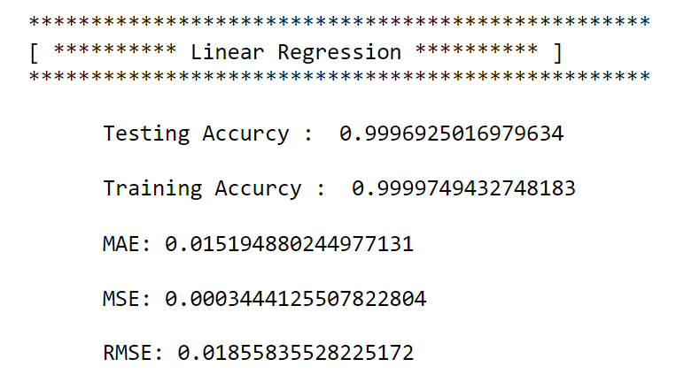
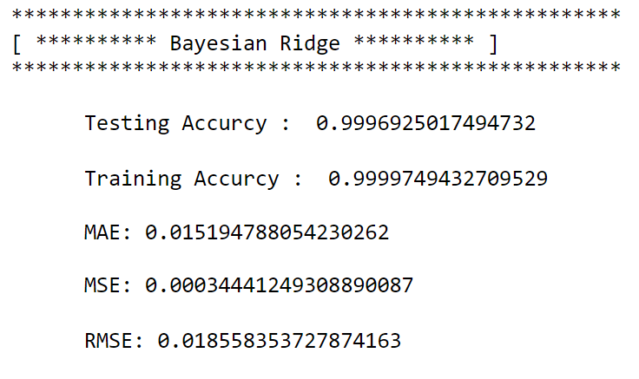
The results :
For the first dataset : EGX_DLY_COMI, 1D
1
2

Slide 6
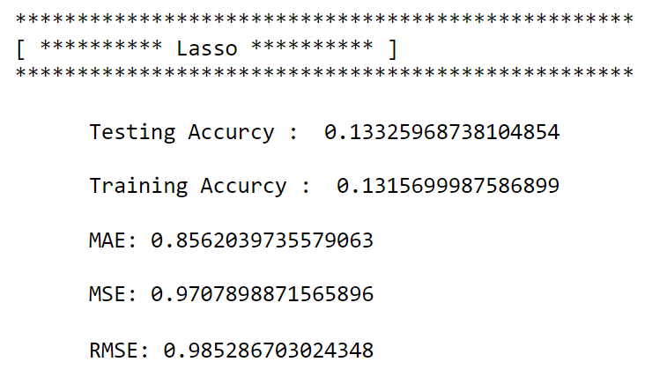
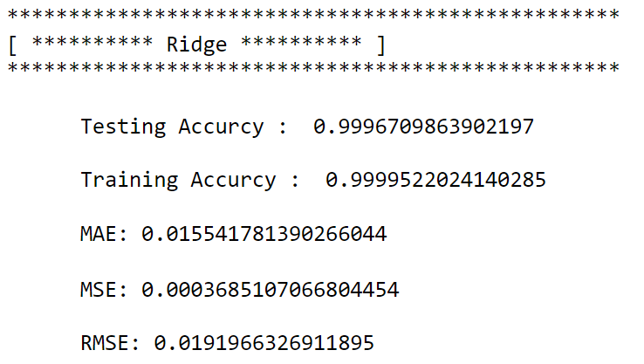
The results :
For the first dataset : EGX_DLY_COMI, 1D
3
4

Slide 7
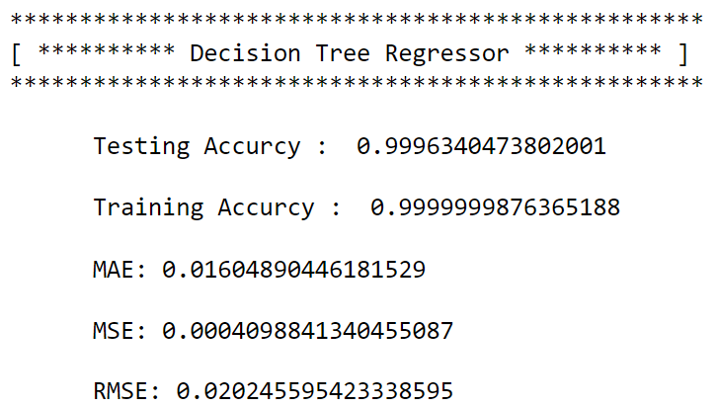
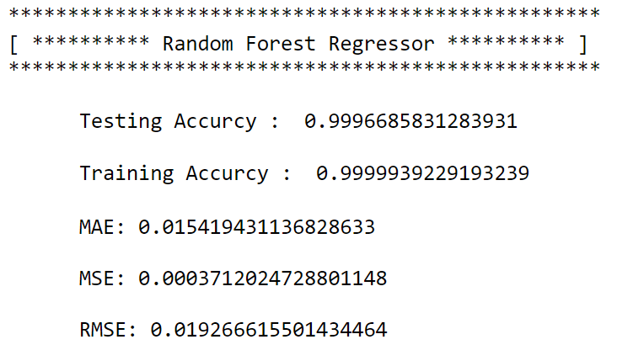
The results :
For the first dataset : EGX_DLY_COMI, 1D
5
6

Slide 8
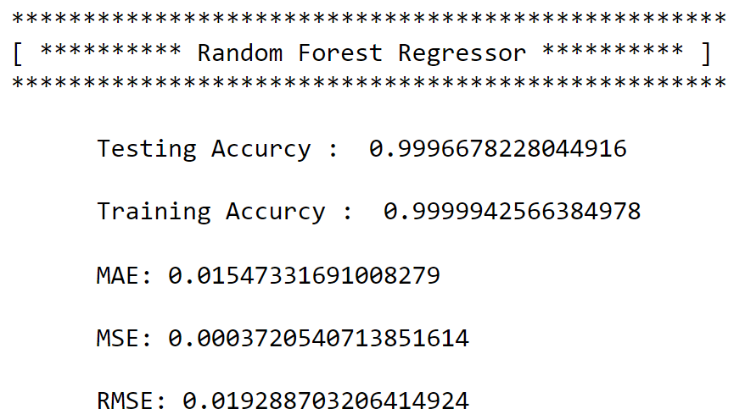
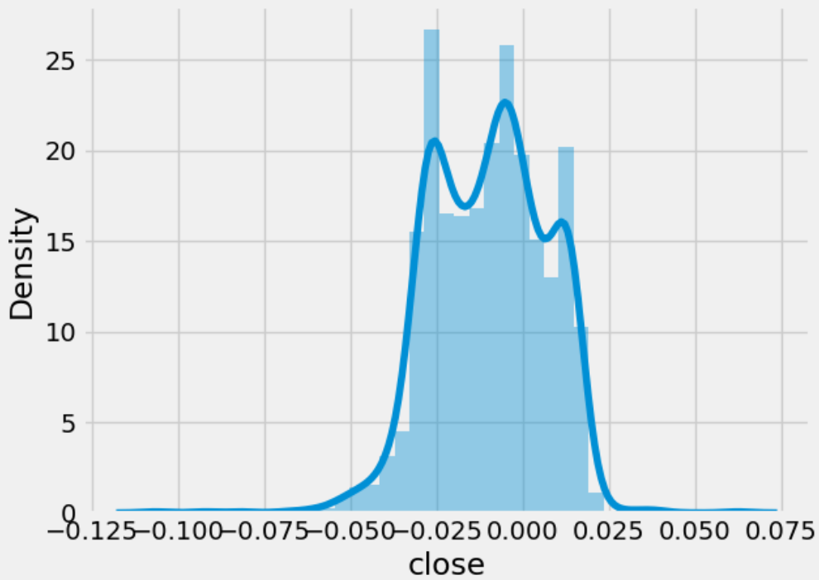
The results :
For the first dataset : EGX_DLY_COMI, 1D
Most of the models provided very high results
Finally, I selected the Random Forest Regressor

Slide 9
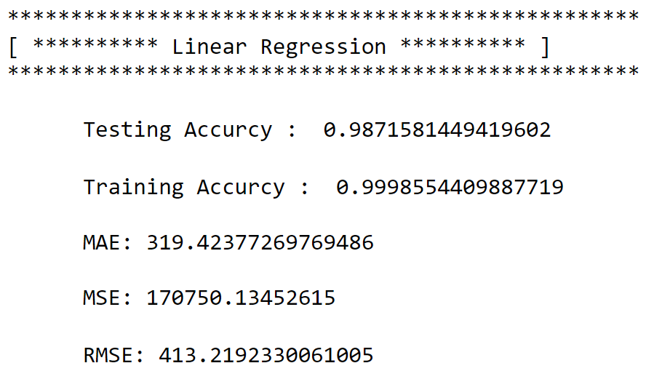
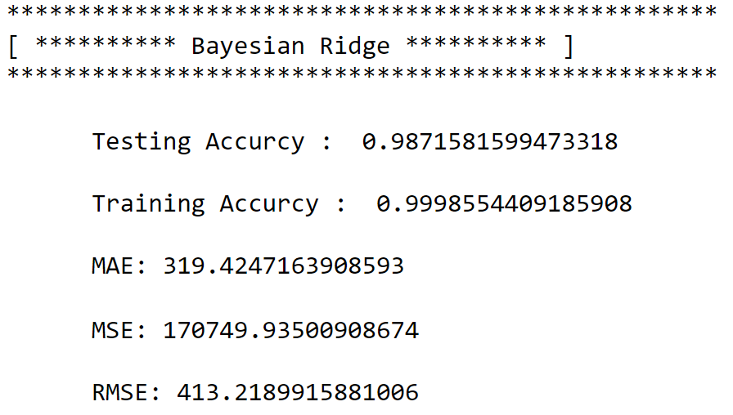
The results :
For Second Dataset(EGX_DLY_EGX30, 1D)
1
2

Slide 10
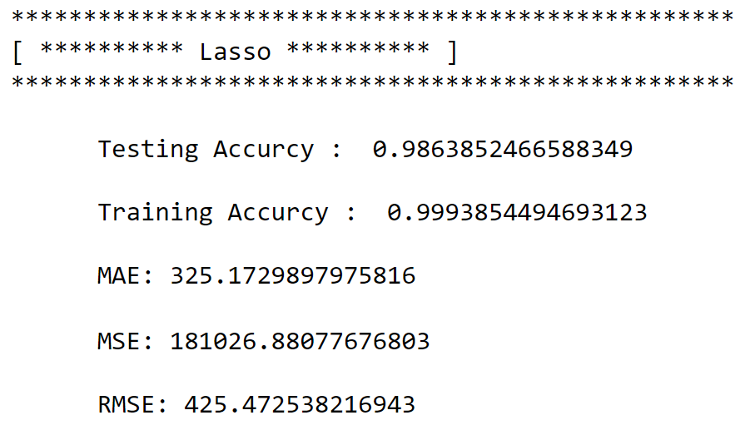
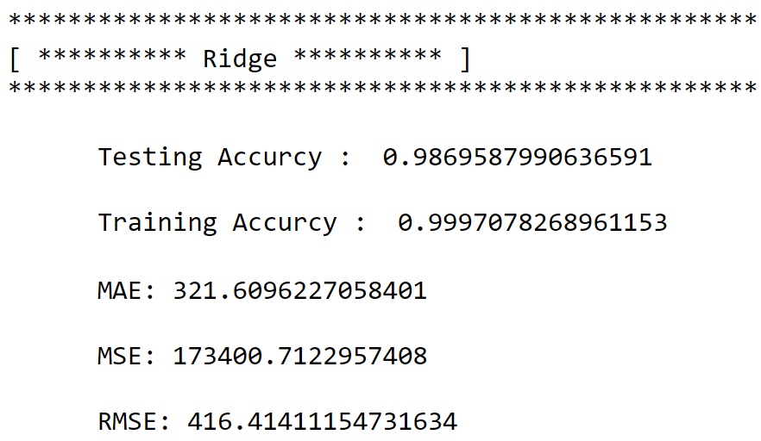
The results :
For Second Dataset(EGX_DLY_EGX30, 1D)
3
4

Slide 11
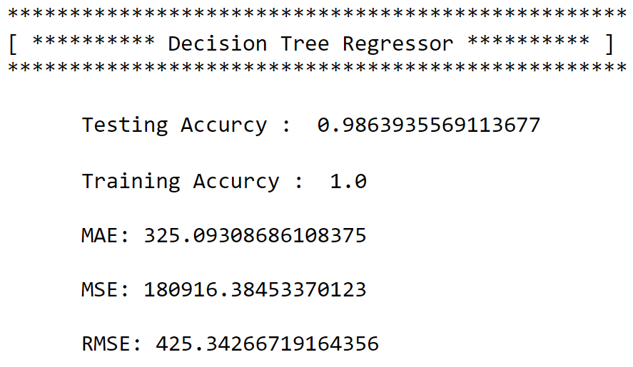
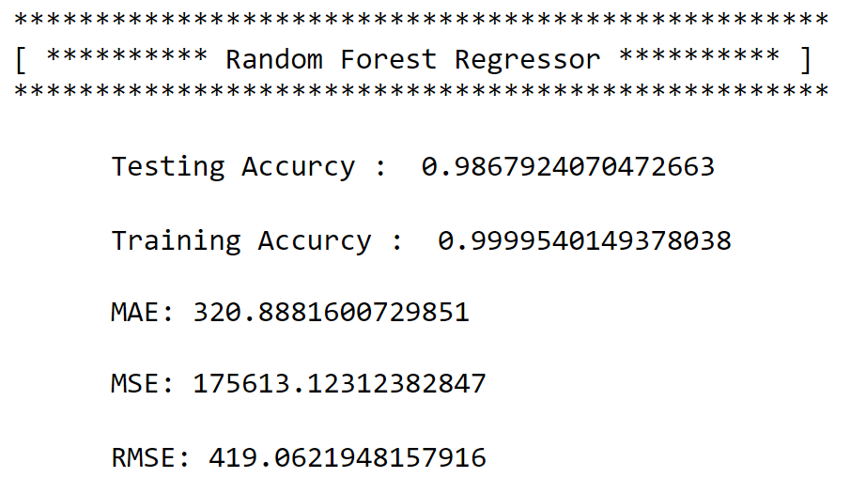
The results :
For Second Dataset(EGX_DLY_EGX30, 1D)
5
6

Slide 12
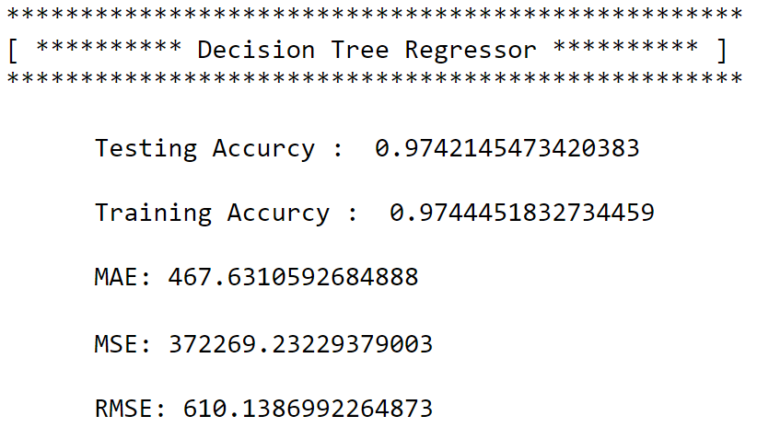
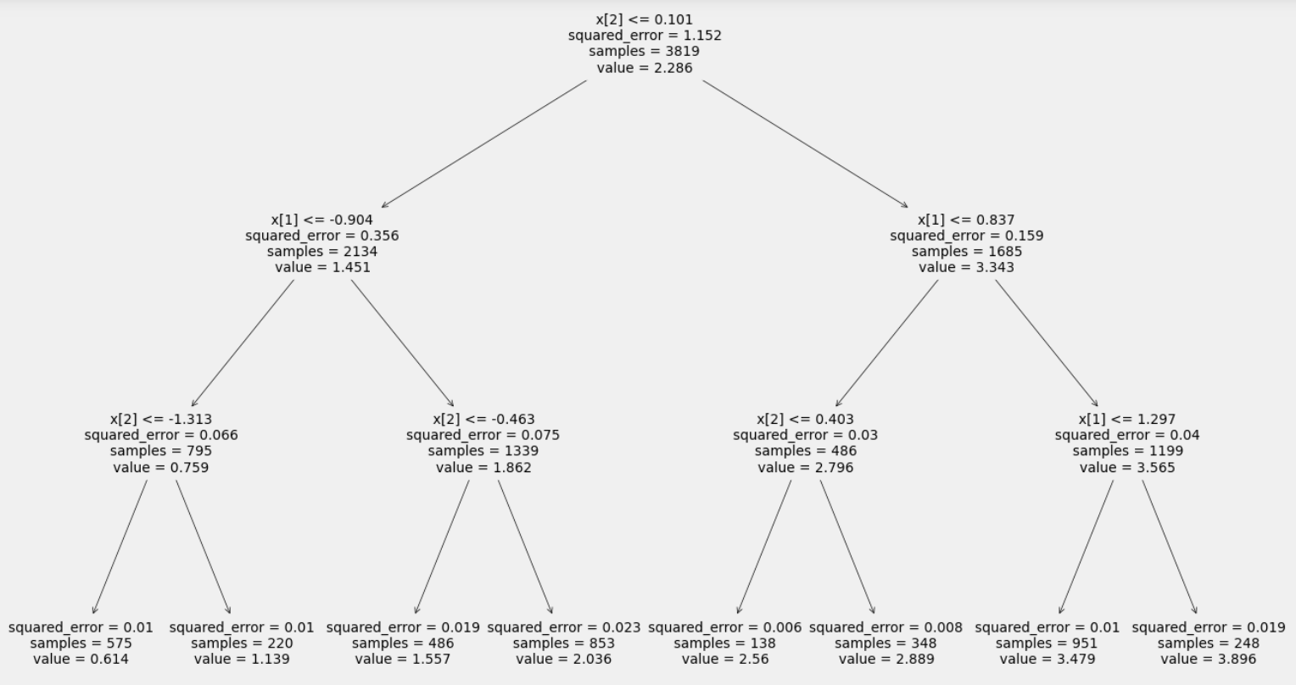
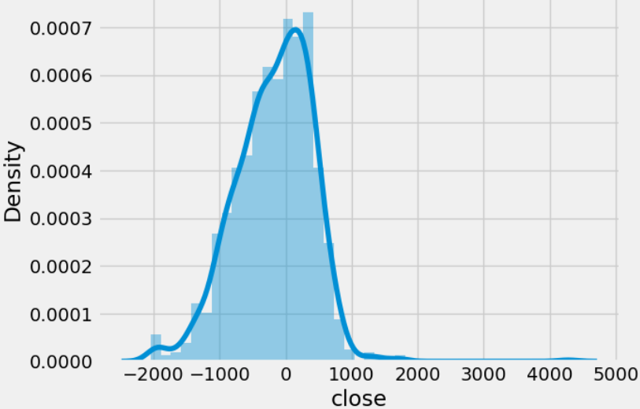
The results :
For Second Dataset(EGX_DLY_EGX30, 1D)
Most of the models provided very high results
Finally, I selected the Decision Tree Regressor

Slide 13
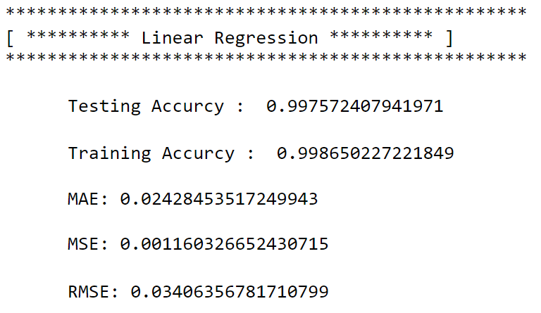
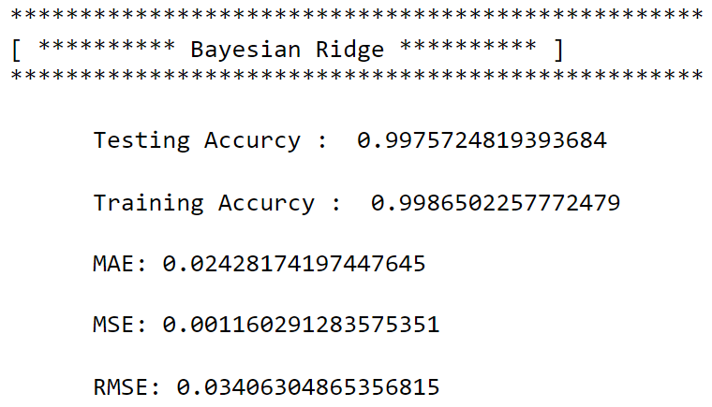
The results :
For Third Dataset(EGX_DLY_EMFD, 1D)
1
2

Slide 14
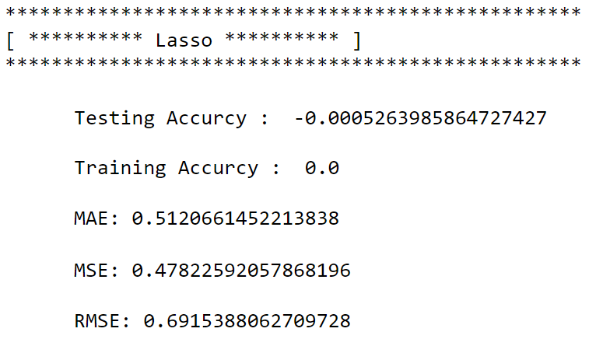
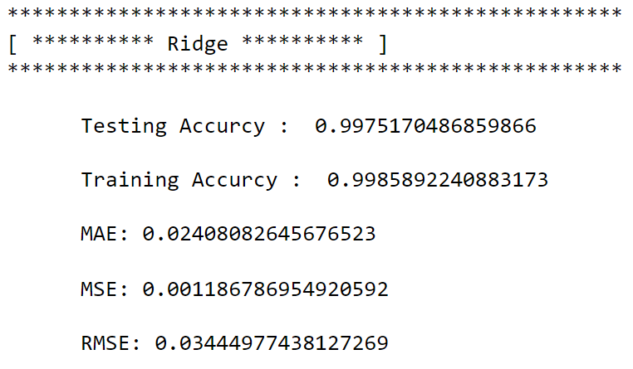
The results :
For Third Dataset(EGX_DLY_EMFD, 1D)
3
4

Slide 15
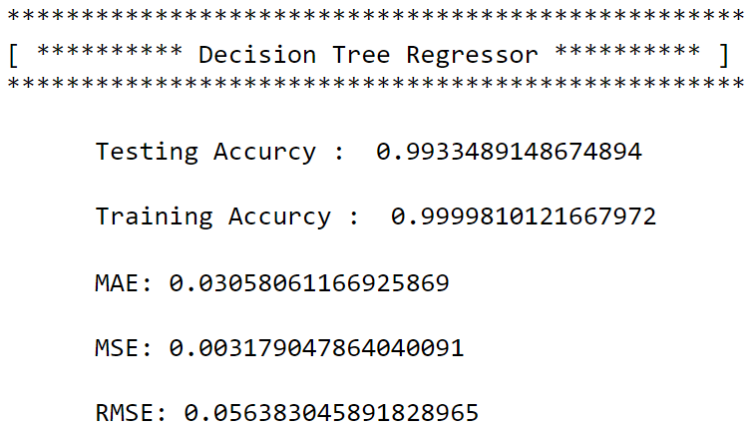
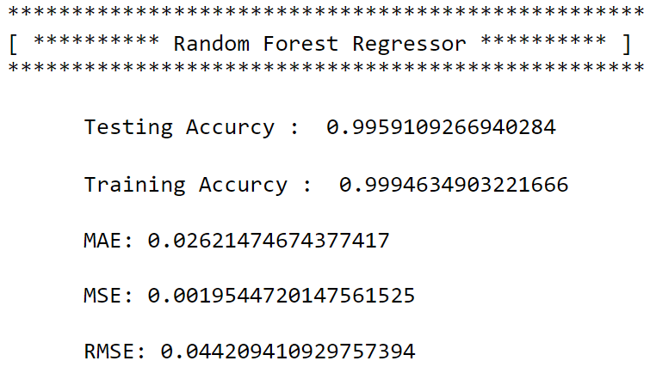
The results :
For Third Dataset(EGX_DLY_EMFD, 1D)
5
6

Slide 16
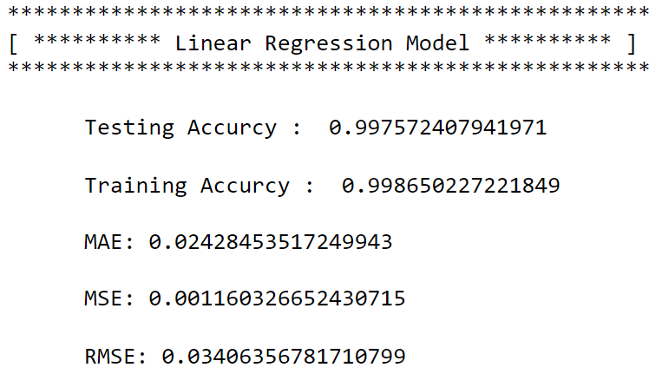
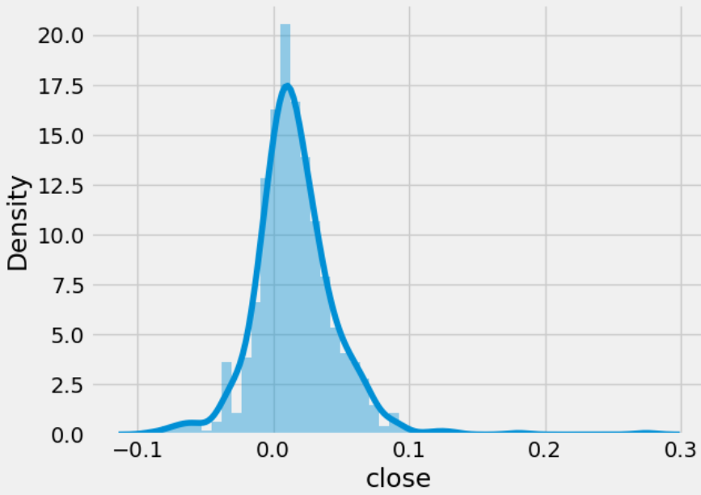
The results :
For Third Dataset(EGX_DLY_EMFD, 1D)
Most of the models provided very high results
Finally, I selected the Linear Regression Model

Slide 17
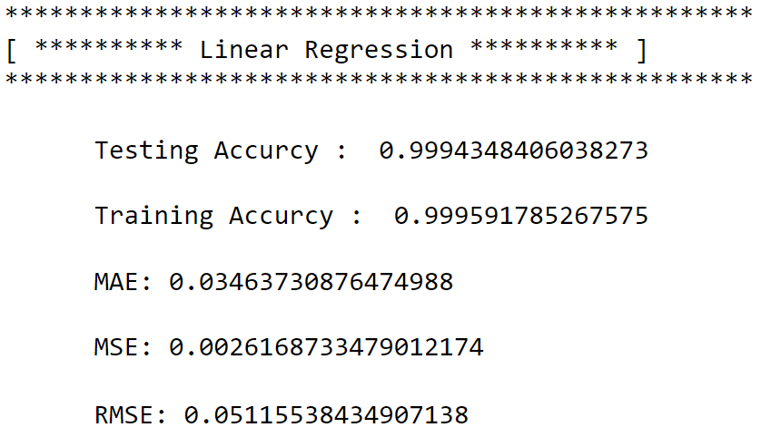
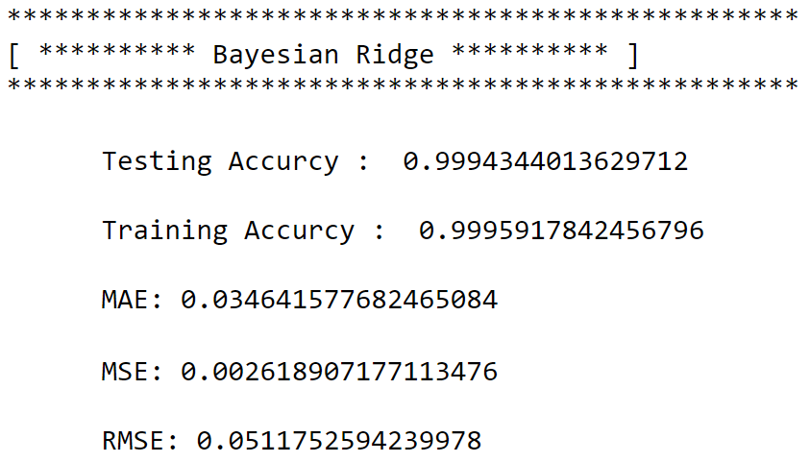
The results :
For Fourth Dataset(EGX_DLY_ISPH, 1D)
1
2

Slide 18
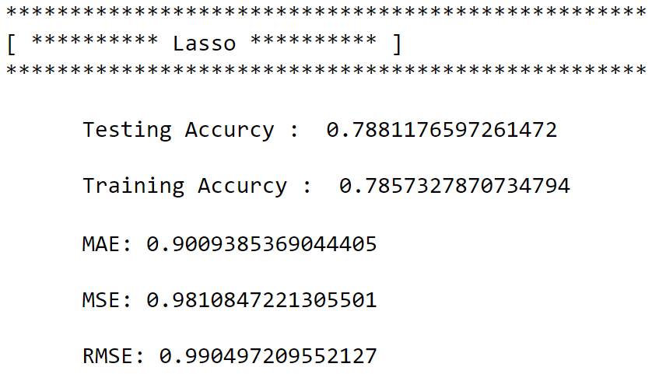
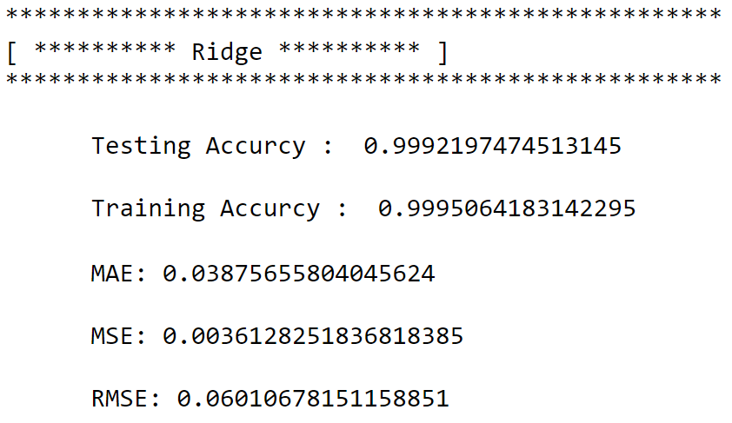
The results :
For Fourth Dataset(EGX_DLY_ISPH, 1D)
3
4

Slide 19
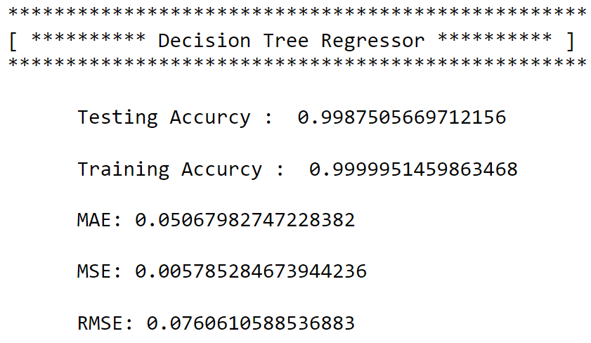
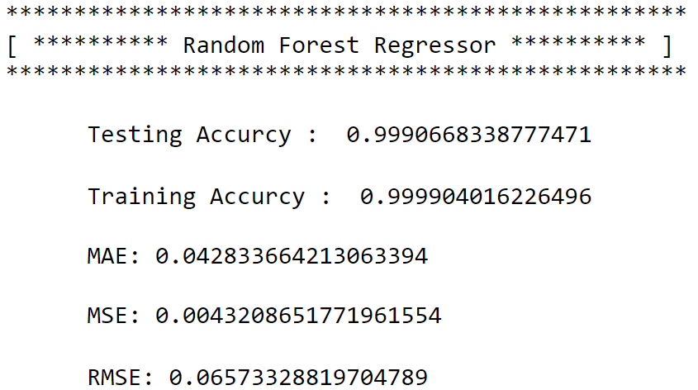
The results :
For Fourth Dataset(EGX_DLY_ISPH, 1D)
5
6

Slide 20
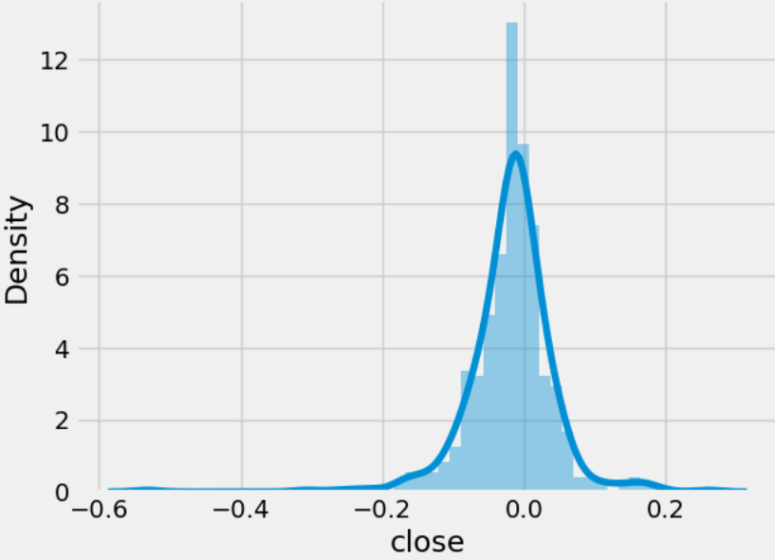
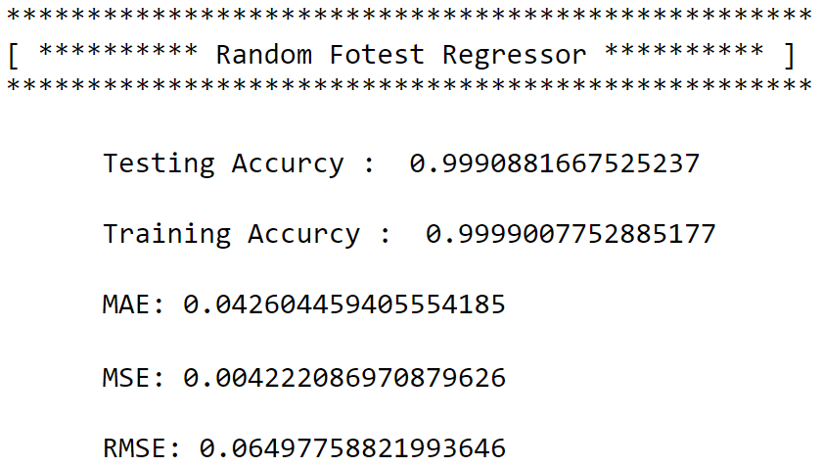
The results :
For Fourth Dataset(EGX_DLY_ISPH, 1D)
Most of the models provided very high results
Finally, I selected the Random Fotest Regressor

Slide 21
Thank You

